Slide 1

INTERNSHIP EXPERIENCE AT EXCELERATE
Team 5a presentation
Date: 04/10/2024.

Slide 2




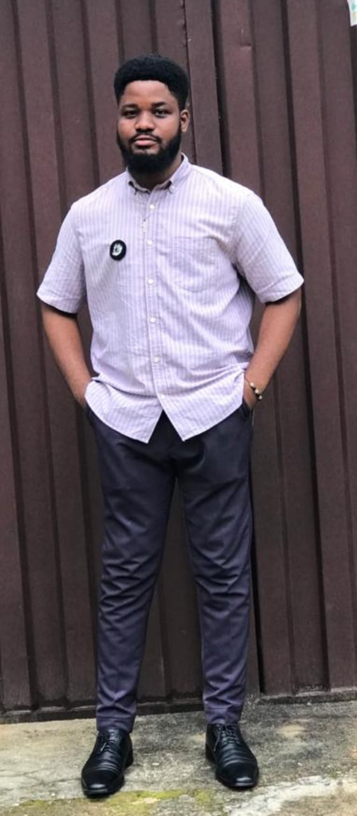
MEET THE TEAM
EMMANUEL ADETUNJI
HONEY OLORUNSOLA
DAVID DANGOJI
KHADIJAT MUHAMMAD
TAYE .M. ADE-OJO
TEAM LEAD
PROJECT LEAD
PROJECT SCRIBE 1
PROJECT MANAGER
PROJECT SCRIBE 2
Liaison with sponsors; ensures seamless communication
Skills:
Excellent communicator; strong leadership
Ensures deadlines and deliverables are met
Skills:
Strong leadership; excellent time management.
Captures meeting minutes and distributes notes for clear team communication.
Ensures deadlines and deliverables are met.
Ensures smooth
delivery of meeting notes.
Skill:
Skills:
Strong organizational abilities, insightful problem-solver.
Skills:
Reliable team player with strong organizational skills.
Detail-oriented, proficient in documentation.

Slide 3
INTRODUCTION
Excelerate is dedicated to empowering students through innovative educational programs and partnerships.
Purpose of the Dashboard: To present actionable insights derived from user data, helping Excelerate understand user demographics and engagement patterns.

Slide 4
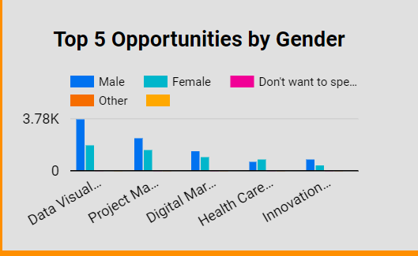
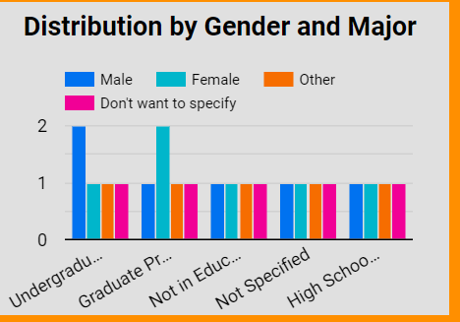
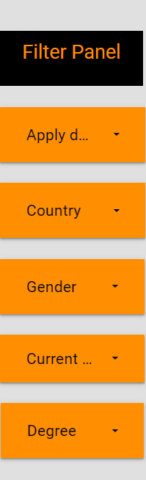
DASHBOARD OVERVIEW
The dashboard is designed to visualize key user metrics, including demographics, engagement rates, and program interest.
Main Components:
User demographics (gender, country, degree)
Sign-up trends over time
Engagement metrics by source (social media vs. traditional)

Slide 5
CHALLENGES FACED & SOLUTIONS IMPLEMENTED
Data integration: There were inconsistencies and missing values in the data provided
Team Meetings:
Tools navigation: navigating the Google Looker Studio was initially a hassle in developing the dashboard, as well as using loom for presentation.
Solutions
Extensive data cleaning and preprocessing
Team Collaboration
Continuous use of the new tools led to proficiency

Slide 6
KEY DECISIONS AND DESIGN CHOICES
Key Decisions:
Selected visualizations include bar charts for demographics and line graphs for trends over time.
Emphasized interactivity to allow users to filter data by different criteria (e.g., country, degree).
The dashboard colour was chosen to fit the colour chosen of excelerate
Rationale:
Visuals were chosen for clarity and quick comprehension, aiding decision-making processes.

Slide 7
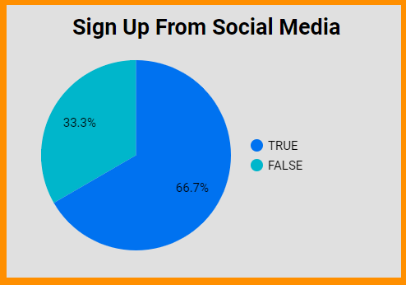
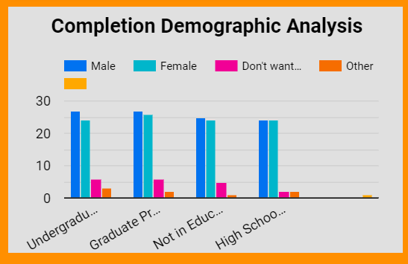
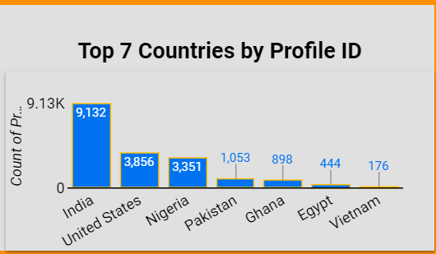
INSIGHTS DERIVED
Compelling Insights:
Diverse user base: Significant representation from India, United States and Nigeria.
High engagement through social media sign-ups (66.7% of users).
Top 3 opportunities are data visualization, project management and Digital marketing
Alignment with Goals:
Insights derived directly support Excelerate's mission to enhance educational opportunities by identifying areas for targeted outreach.

Slide 8
IMPACT ON DECISION-MAKING
Potential Impact:
The insights derived from the dashboard can inform strategic decisions related to future program development and marketing.
By tracking user engagement, Excelerate can focus on high-demand opportunities and target regions with low engagement with outreaches.
By understanding user preferences and engagement, Excelerate can tailor its initiatives to better meet the needs of its target audience.

Slide 9
CONCLUSION
Data driven exploration has provided rich insights into user behaviour and educational trends.
This dashboard enhances visibility into user behavior, allowing for better planning and decision-making in alignment with Excelerate’s goals.
Key takeaways include the importance of understanding user needs and adapting strategies accordingly to enhance engagement.
There is identifiation of key geographic and demographic areas for targeted marketing and strategies

Slide 10
RECOMMENDATIONS
Data Collection should be enhanced for qualitative insights
Targeted Marketing Strategies for underrepresented demographics
Leveraging social media to engage younger audience with trends and influencers
Interactive Content Development should be organized to boost engagement
Partnernership with IT firms for Training and Resources on advanced analytical tools to gain deeper

Slide 11
THANK YOU

